Slide 1
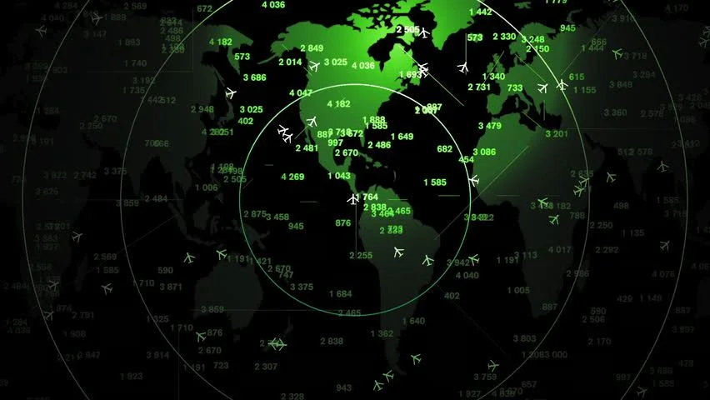
Air Traffic Flow Management
Vishal Shrivastava (19D110025)
Om Prabhu (19D170018)

Slide 2
Contents
Introduction To Problem
Problem Formulation
Solving The Problem
Uncertainty Analysis
Future Work

Slide 3

Motivation
22% of flights delayed or cancelled between 2004 and 2017
Very challenging due to highly random factors involved (eg: adverse weather)
Air transport is a major sector of the global economy
Billions of dollars lost in rerouting aircraft & compensating passengers for cancelled flights

Slide 4
Problem Description
Consider 3 centers with well defined airspace boundaries comprising multiple airports each and a day divided into ‘k’ equal time intervals
Optimise the number of aircraft departing from & arriving at each center as well as travelling between centers in each time interval such that the cost of airborne delay and ground hold delay is minimized
Cost is directly proportional to the number of scheduled flights that have to be delayed/cancelled and in-transit flights that undergo airborne delays

Slide 5
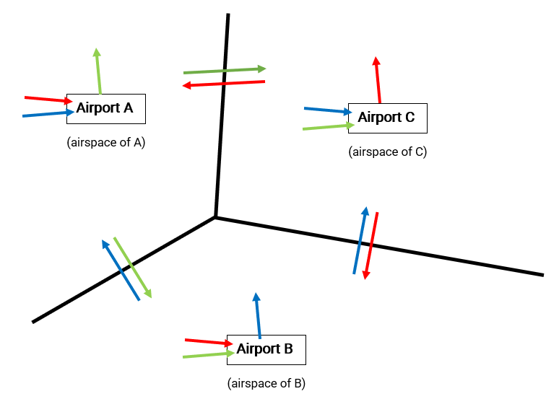
Problem Description

Slide 6
Assumptions
All aircraft are identical (same cost/time delay)
There are no connecting flights
We consider only the flights which travel between the 3 designated centers (eg: center A may have flights travelling to a fourth center, say D - these flights are not considered)
Arrivals at and departures from the airports of a center happen at the end boundary of the time interval
Transition across airspace boundaries of centers happen only when there is a transition across time boundary as well
Stochasticity in the form of adverse weather, airport crowd congestion, etc are not accounted for

Slide 7
Contents
Introduction To Problem
Problem Formulation
Solving The Problem
Uncertainty Analysis
Future Work

Slide 8
Parameters
x_{i}(k): Total number of aircraft in airspace of center ‘i’ at the start of time interval ‘k’
Capacity_{i}(k): Total capacity of all airports in center ‘i’ during time interval ‘k’
SchDept_{i}(k): Scheduled departures from airports in center ‘i’ during time interval ‘k’
DeptLim_{i}(k): Limit on departures from airports in center ‘i’ during time interval ‘k’
ArrivLim_{i}(k): Limit on arrivals at airports in center ‘i’ during time interval ‘k’
TrafLim_{ij}(k): limit on traffic flow between airspace boundaries of centers ‘i’ & ‘j’ during time interval ‘k’
C_{i}: cost factor for delay in center i (different for ground holding, C_{g} and airborne holding C_{a})

Slide 9
Decision Variables
β_{ij}(k): fraction of airborne aircraft in center ‘i’ that move to center ‘j’ during time interval ‘k’
D_{i}(k): Total number of departures from the airports in center ‘i’ during time interval ‘k’
A_{i}(k): Total number of arrivals at the airports in center ‘i’ during time interval ‘k’

Slide 10
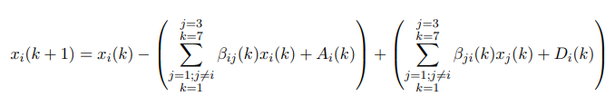
Constraints
Airborne Aircraft Balance Constraint:
start
end
start
end
Kth interval
(K+1)th interval
x_{i}(k)
+D_{i}(k)-A_{i}(k)
∑ꞵ_{ij}(k)x_{i}(k)
∑ꞵ_{ji}(k)x_{j}(k)
Airspace of center ‘i’
Airspace of center ‘j’

Slide 11
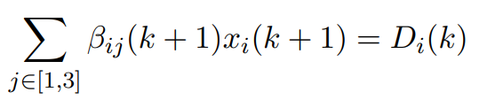
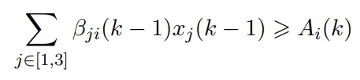
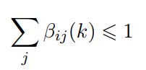
Constraints
Airport Departures Contribution To Airspace Constraint:
Airport Arrivals Contribution To Airspace Constraint:
Beta Constraint:

Slide 12
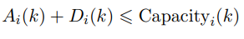
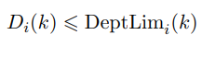
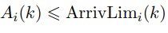
Constraints
Capacity Constraint:
Departures Limit Constraint:
Arrivals Limit Constraint:

Slide 13
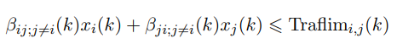
Constraints
Boundary Traffic Limit Constraint:
Center ‘i’
ꞵ_{ji;j≠i}(k)x_{j}(k)
ꞵ_{ij;j≠i}(k)x_{i}(k)
Center ‘j’

Slide 14
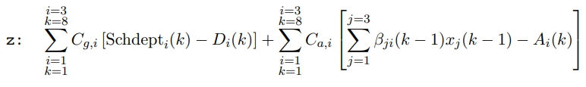
Objective
Minimize the cost function:
First summation corresponds to ground holding costs (i.e. cost of holding flights that were scheduled for departure but did not actually depart)
Second summation corresponds to airborne delay costs (i.e. delay costs of flights that were scheduled to arrive in a specific time interval but did not actually arrive)
C_{a,i} > C_{g,i} : cost of holding aircraft in flight is costlier than holding on ground

Slide 15
Contents
Introduction To Problem
Problem Formulation
Solving The Problem
Uncertainty Analysis
Future Work

Slide 16
Optimizing Tools
Data for scheduled departures has been taken from real-life average data for Mumbai, Delhi and Hyderabad airports respectively
The optimization software used for modelling & solving this problem is AMPL and the solver used is Couenne
Model statistics:
Parameter | Value
Optimal Objective Value | 118.41
Total Constraints | 104
Total Variables | 129 (48 integer)
Execution Time | 0.169 sec

Slide 17
Obtained Solution
Beta [1,*,*] (tr)
: 1 2 3 :=
0 0.964655 0.026724 0.015848
1 0.228241 0.314352 0.125484
2 0.0515152 0.095452 0.051416
3 0.051534 0.247222 0.623481
4 0.352315 0.041637 0.143981
5 0.139823 0.403097 0.015324
6 0.089846 0.078695 0.425760
7 0.0666667 0.812546 0.087462
8 0.656098 0.047213 0.141635
[2,*,*] (tr)
: 1 2 3 :=
0 0.025503 0.210084 0.080147
1 0.569492 0.032740 0.011452
2 0.305056 0.407022 0.119382
3 0.298377 0.102273 0.157792
4 0.0553957 0.729137 0.157463
5 0.284975 0.096031 0.187192
6 0.274806 0.334104 0.124806
7 0.0666667 0.734783 0.184058
8 0.354545 0.532111 0.009778
[3,*,*] (tr)
: 1 2 3 :=
0 0.084161 0.048631 0.715456
1 0.129365 0.001364 0.614286
2 0.055318 0.074182 0.634471
3 0.741255 0.079681 0.063265
4 0.021212 0.100412 0.361538
5 0.415520 0.325287 0.095024
6 0.742314 0.014935 0.061290
7 0.136842 0.074763 0.524694
8 0.243752 0.642477 0.032748
;
: A D :=
1 0 20 15
1 1 60 15
1 2 100 25
1 3 50 59
1 4 52 67
1 5 49 14
1 6 78 8
1 7 43 31
1 8 13 37
2 0 20 15
2 1 52 148
2 2 43 86
2 3 81 116
2 4 36 106
2 5 110 58
2 6 84 68
2 7 14 35
2 8 35 58
3 0 20 15
3 1 19 18
3 2 50 21
3 3 37 30
3 4 31 37
3 5 46 10
3 6 48 27
3 7 25 11
3 8 17 23
;

Slide 18
Contents
Introduction To Problem
Problem Formulation
Solving The Problem
Uncertainty Analysis
Future Work

Slide 19
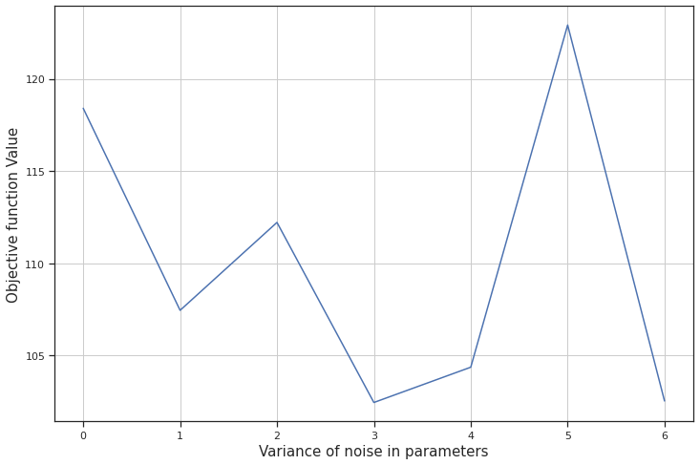
Uncertainty Analysis
On adding Gaussian noise to the parameter x_{i}(k) and SchDept_{i}(k), we observe the variation in the value of the objective function when the variables β_{ij}(k), A_{i}(k) and D_{i}(k) take the optimal values for original value of parameters
% maximum change in cost function value = 100* (118.41-102.45)/118.41 = 13.48%
Maximum variance = 6

Slide 20
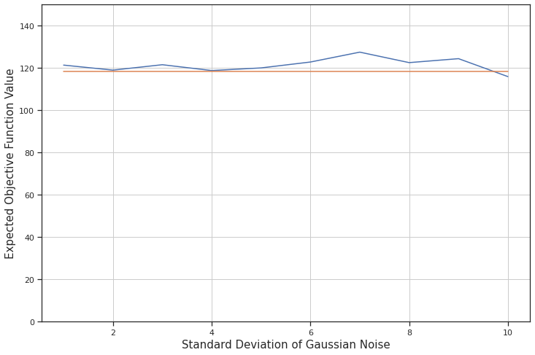
Uncertainty Analysis
Maximum deviation from the optimal value = 7.98%
For small perturbations in environment parameters, the solution is reasonably robust
Noise added is gaussian represented using 200 samples from the respective distribution

Slide 21
Contents
Introduction To Problem
Problem Formulation
Solving The Problem
Uncertainty Analysis
Future Work

Slide 22
Future Work
Develop a suitable disaggregation algorithm to extract finer instructions for every airport from the obtained results
Extend the problem to even more airports/centers (can theoretically be extended to all airports in the world)
Extend the model to account for different types of aircraft (size and capacity)
Extend the model to account for connecting flights
Increase complexity of problem by shrinking time intervals to ensure more exact predictions
Incorporate stochasticity in the form of uncertain weather conditions, airport congestion, wind turbulence, etc
Employ open source air traffic simulators such as bluesky and openscope for better visualization of obtained results

Slide 23
References & Links
An Integer Optimization Approach to Large Scale Air Traffic Flow Management - Bertsimas, Lulli, Odoni (2011)
The Traffic Flow Management Rerouting Problem in Air Traffic Control: A Dynamic Network Flow Approach - Bertsimas, Patterson (2000)
Disaggregation Method for an Aggregate Traffic Flow Management Model - Sun, Shridhar, Grabbe (2010)
Control and Optimization Algorithms for Air Transportation Systems - Balakrishnan (2016)
Link to Github repository for our project: https://github.com/VishalSriv15/Air-Traffic-Flow-Management.git

Slide 24
Thank You

